Slide 1


Lights, sound, movement:
Taking cosplay to the next level with Arduino
Presented by Arsenio Dev and 64_B1T

Slide 2
Who we are

Slide 3
Basic terms to know
HIGH- logical 1 or 5v
LOW- logical 0 or 0v
LED- Light Emitting Diode
Library- wrapper for functions
Servo- DC motor that goes to an angle
Addressable- individually controllable
Magic smoke- makes everything work
.ino- Arduino file extension
Decoupling cap- smooths power spikes
Neopixel- name for WS2812B addr LED
IMU- Inertial measurement unit
Amplifier- increases signal level (loudness)

Slide 4
Simple lights
Standard LEDs are dead easy, apply voltage or pull any digital pin HIGH to light.
Or to dim, connect to analog pin, call analogWrite(x); Where X is between 0-255

Slide 5
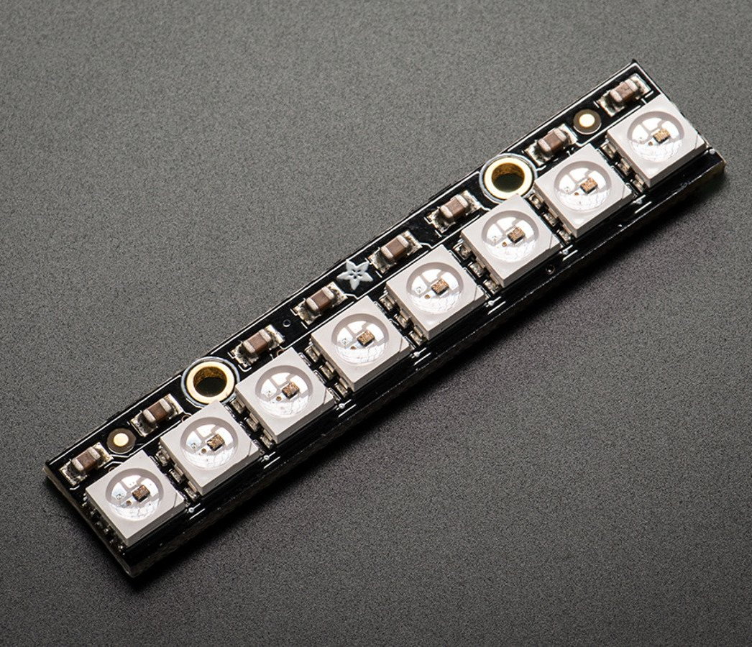
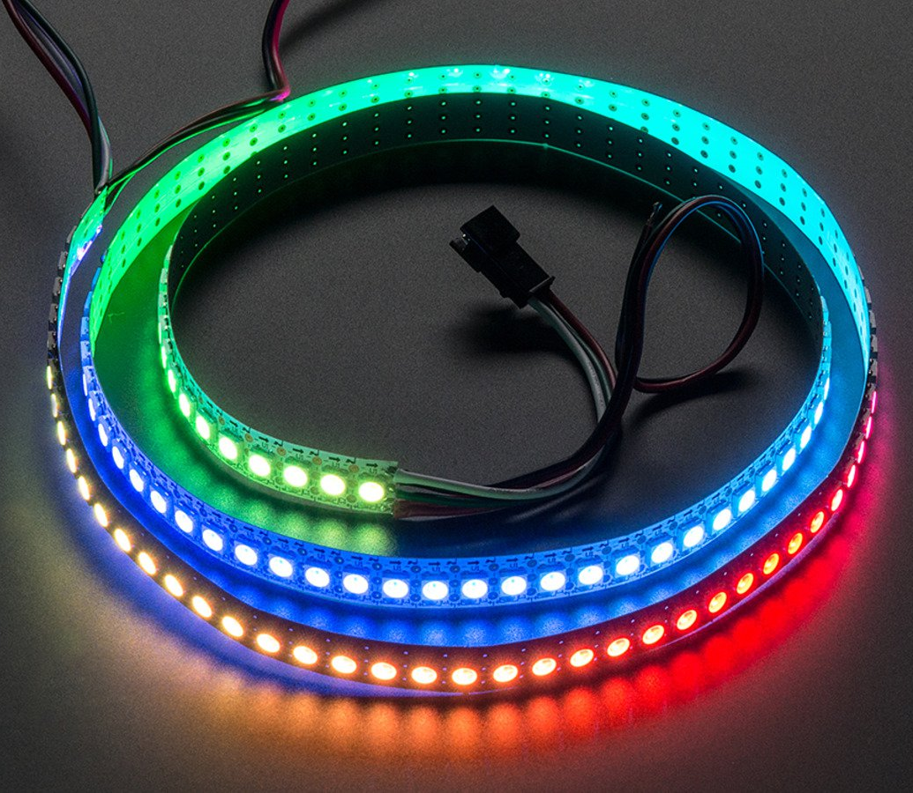
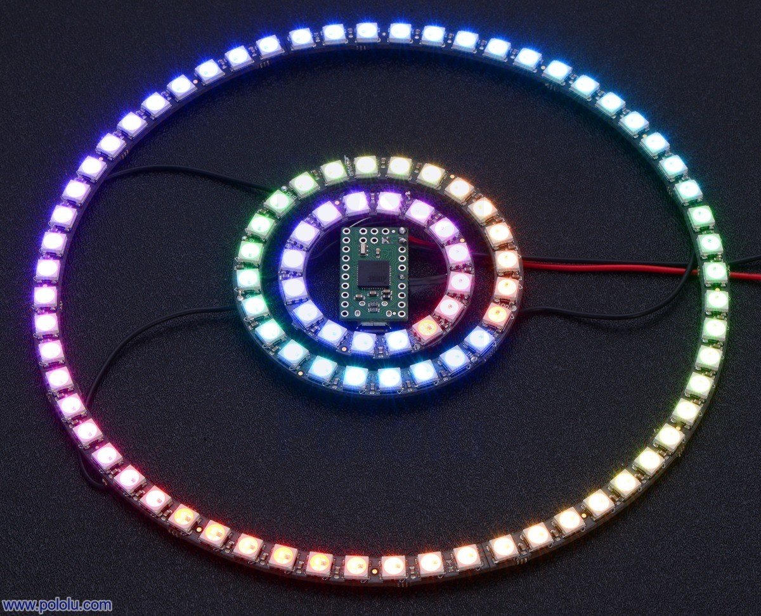
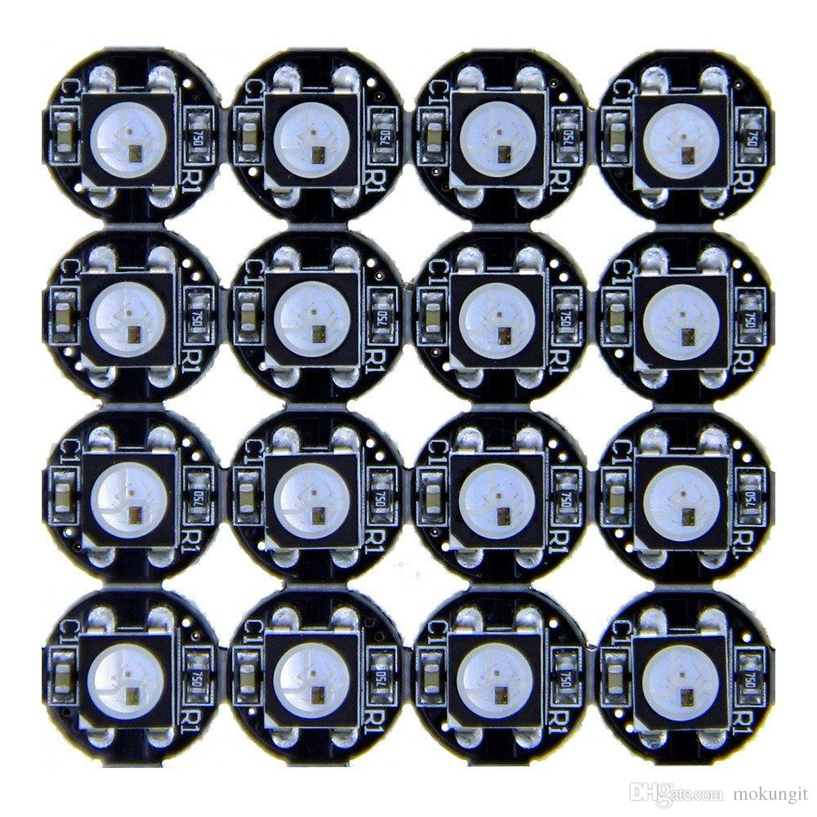
Types of WS2812 LEDs

Slide 6
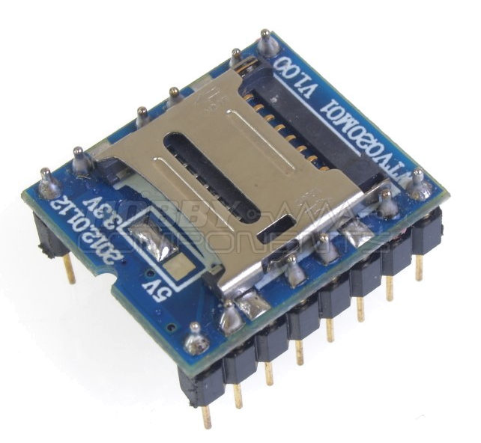
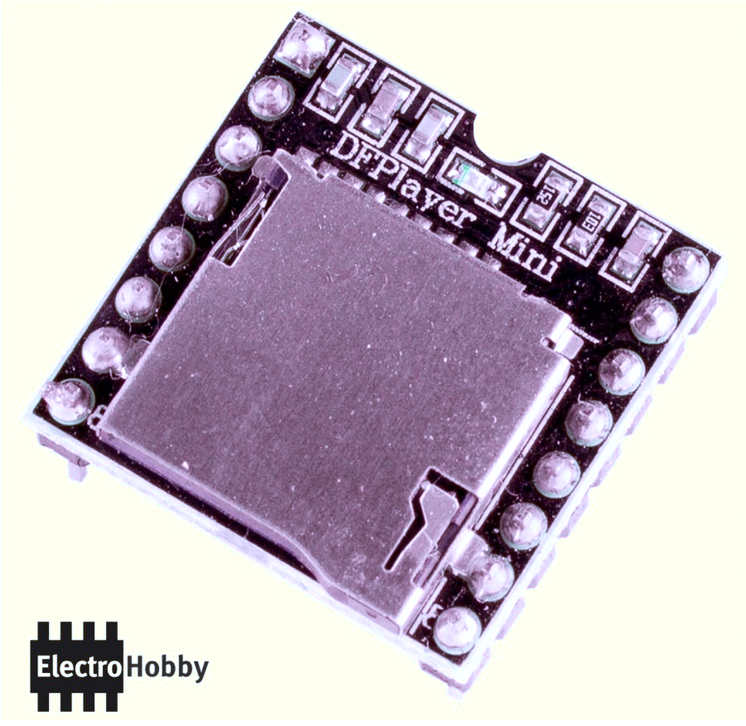
Sound module types and warnings
Very finicky, only takes certain 2gb sd cards
Only plays au3 files, too much noise
Easy to use, MP3 support, up to 32gb cards, amps on output, only $2 more

Slide 7
Want to add Wi-Fi control? Sure why not!
ESP-8266 is the current gold standard, <$5 for a board including USB
Can operate as either it’s own network or connect to one.
Serve basic webpages from flash storage

